Slide 1
Lecture 12 Social Media and its Impacts on Society (continued)

Slide 2

Facebook
Source: www.niu.edu/stuaff/division_employee.../Social_Media_101.ppt‎
2

Slide 3
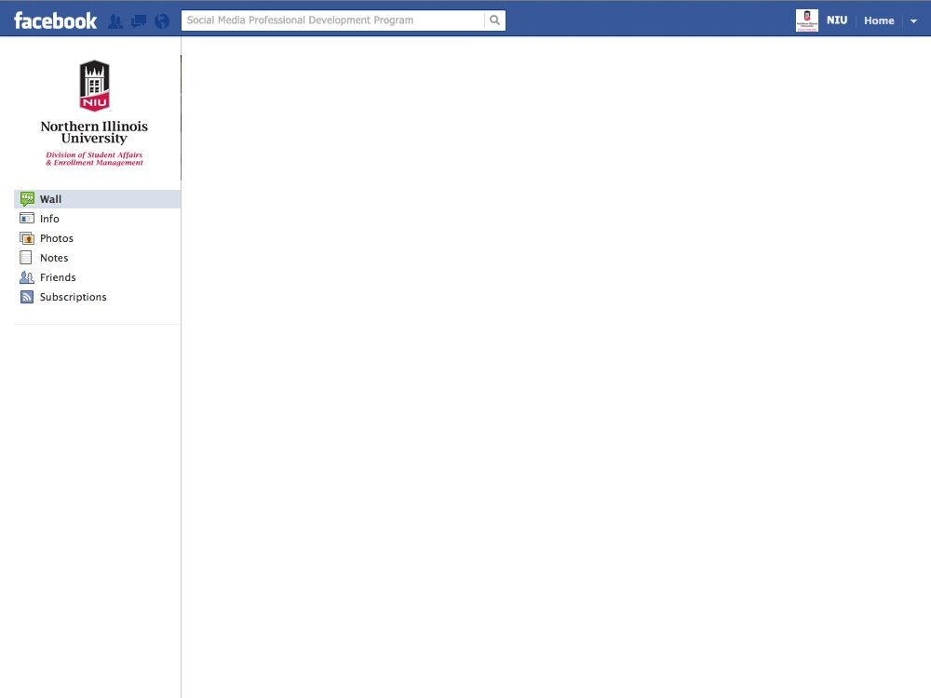
Facebook: What is it?
Social networking tool, allowing users to connect with each other online
Allows individuals to create profiles that include almost anything they want to post
Dynamically links users’ information to others with similar information
Allows for easy, spontaneous networking accessible online or on mobile devices

Slide 4
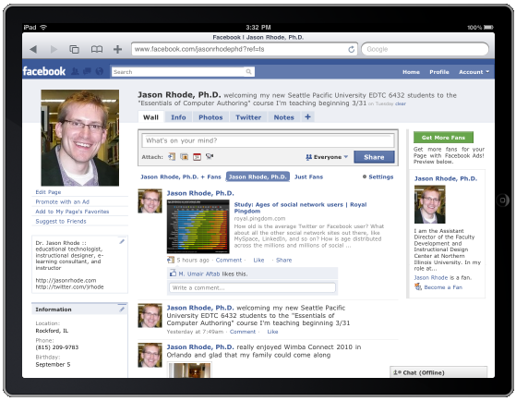
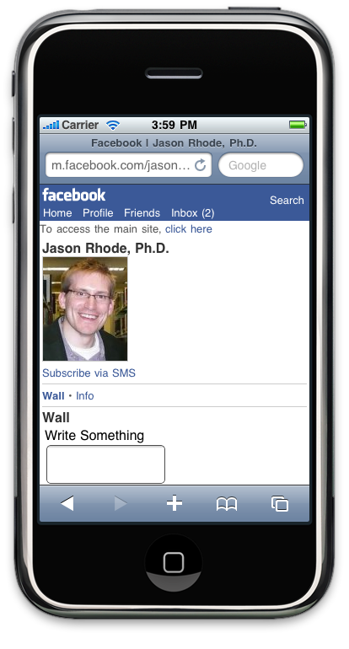
Optimized for Mobile Platforms

Slide 5
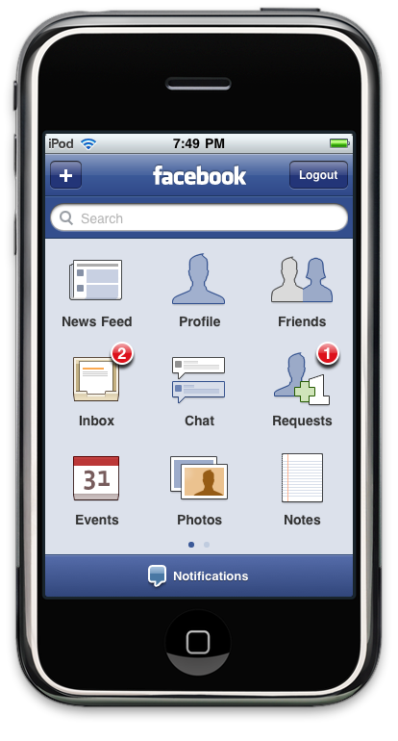
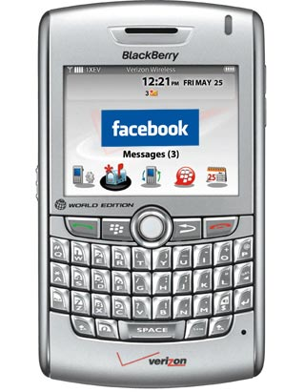
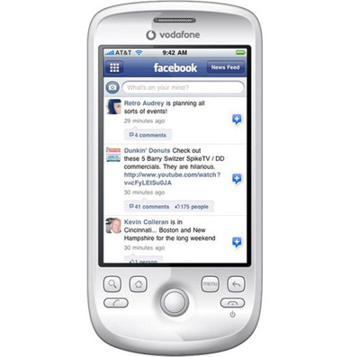
Native Apps for Mobile Devices

Slide 6
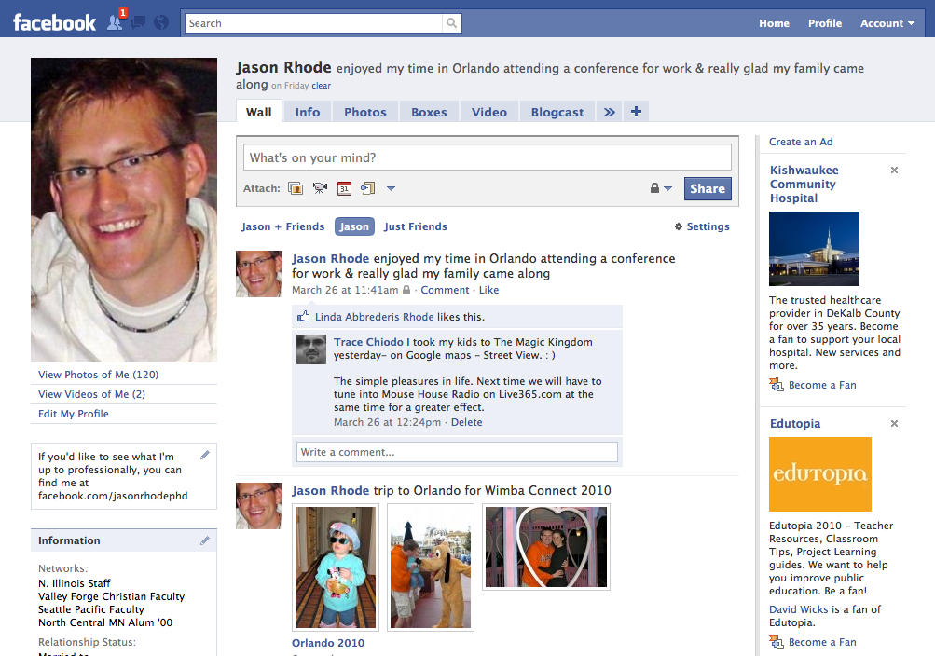
Profiles

Slide 7
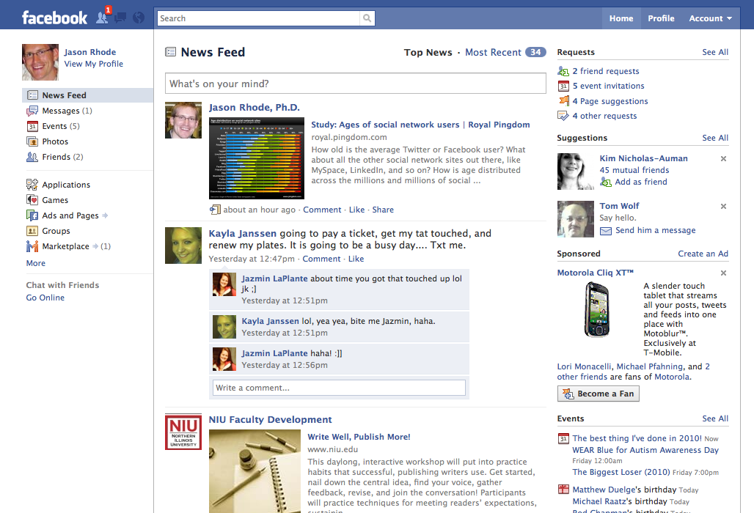
News Feed

Slide 8
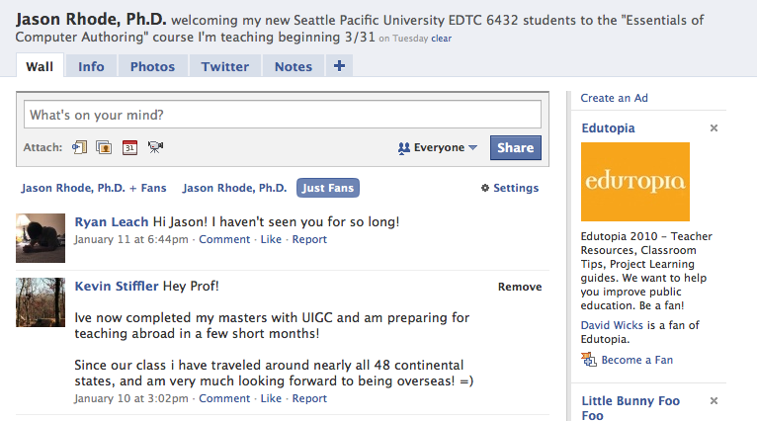
Wall

Slide 9
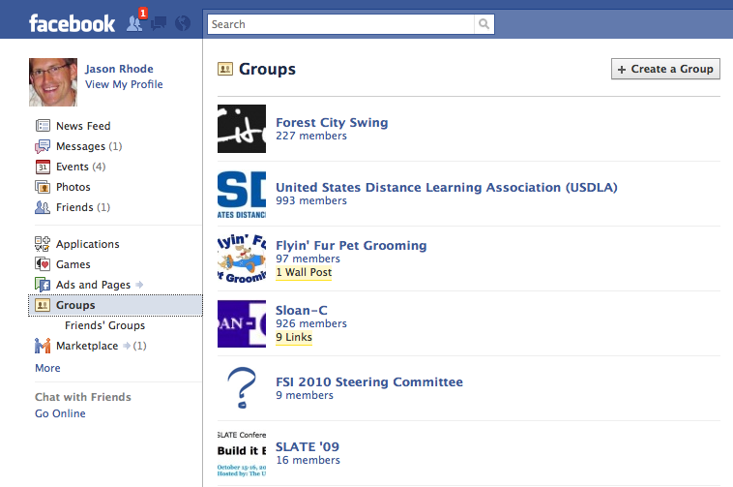
Groups

Slide 10
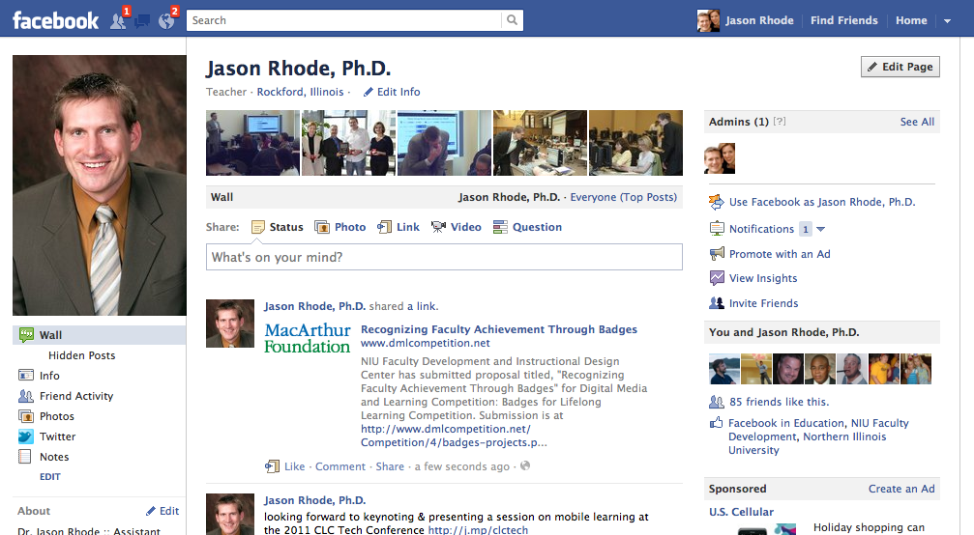
Personal Pages
facebook.com/jasonrhodephd

Slide 11
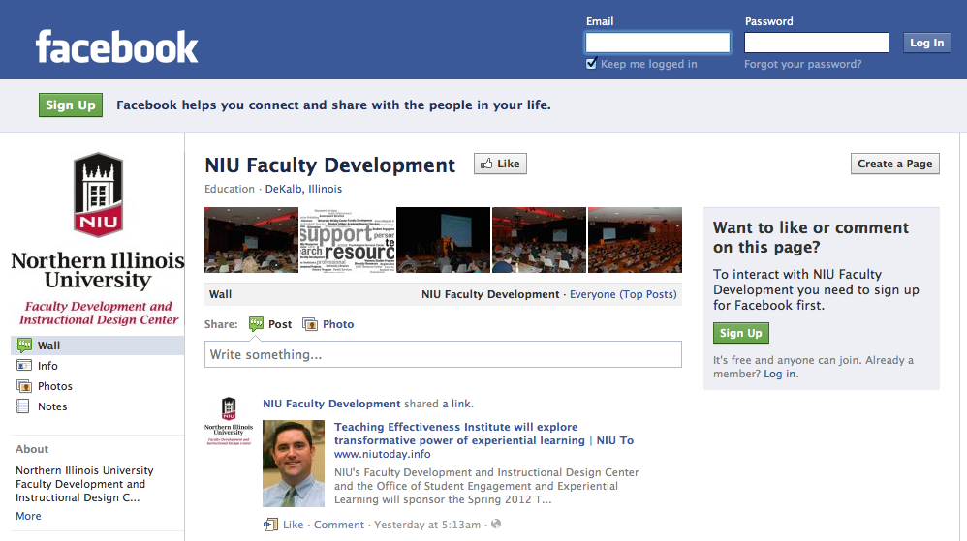
Organization Pages
facebook.com/facdev

Slide 12
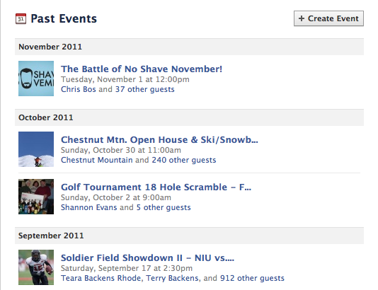
Events
facebook.com/events

Slide 13
Groups vs. Pages
Facebook Groups
Facebook Pages
No updates
No applications
No usage stats
Open, closed, or secret
Not indexed by external search engines like Google
Updates directly to user news feeds
Can add many applications
Usage stats including visitors per day
Public
Indexed by external search engines like Google

Slide 14
Fans vs. Friends
Facebook Fans
Facebook Friends
Can view any public posts to a public Page Wall
Status updates posted to a Page appear in Fans’ news feed
Acquaintances
Can post to Page Wall
Can view posts to a Friend’s Wall as set via user’s privacy settings
Status updates posted to a Profile appear in Friends’ news feed
Personal friends & family members
Can post to Friend’s Wall

Slide 15
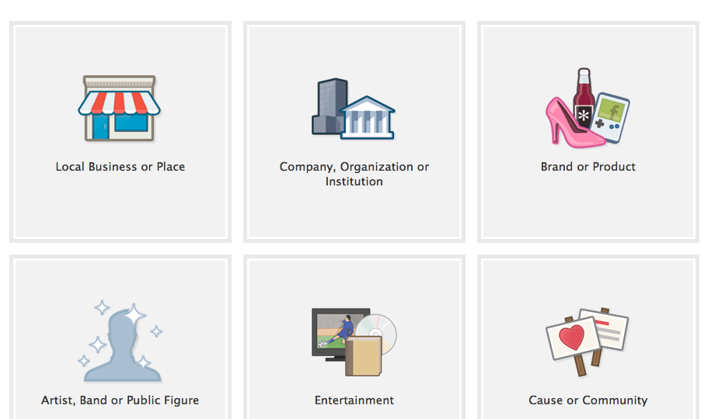
Create a Page
facebook.com/pages/create.php

Slide 16
Create a Group
facebook.com/groups

Slide 17
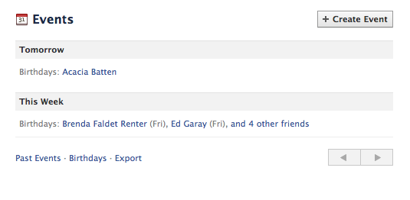
Create an Event
facebook.com/events/create

Slide 18
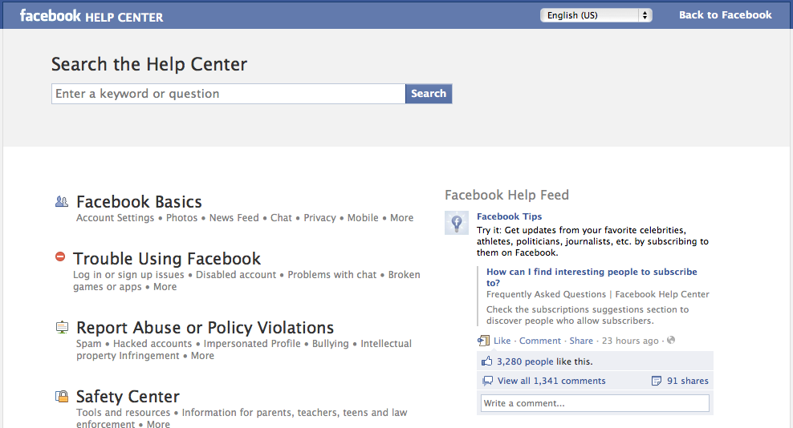
Facebook Help Center
facebook.com/help

Slide 19

Twitter
19

Slide 20
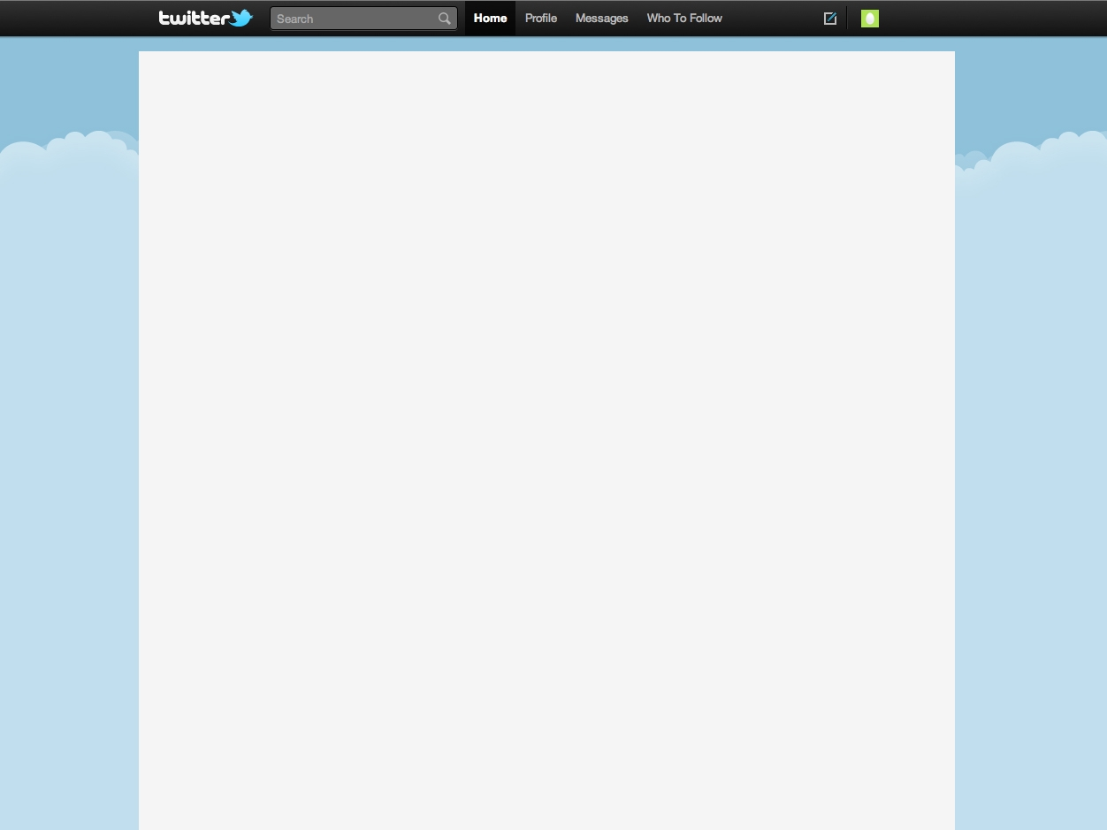
Twitter Described
“Part blog, part social networking site, and part cell phone/IM tool. It is designed to let users describe what they are doing or thinking at a given moment, in 140 characters or less”

Slide 21
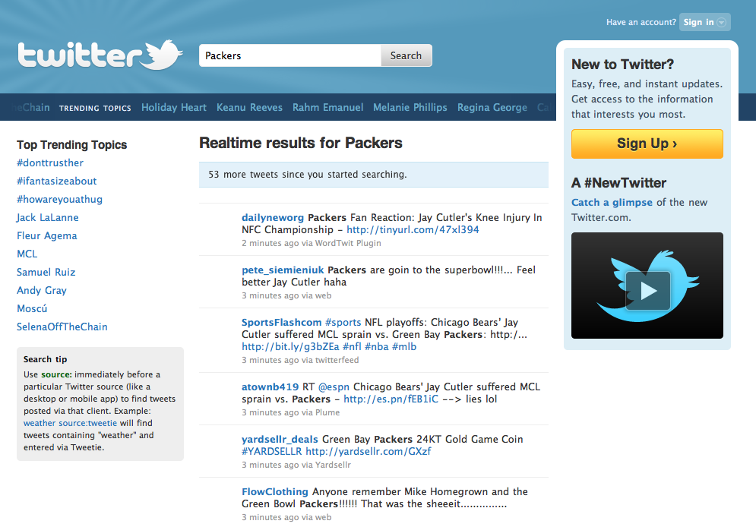
Twitter Search

Slide 22
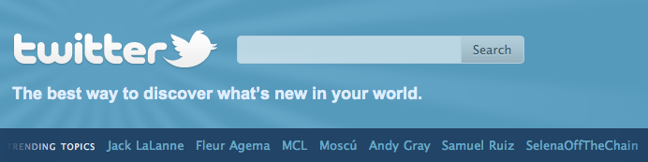
Trending Topics
"most breaking" news stories from across the world; hottest emerging trends and topics of discussion on Twitter

Slide 23
Platform Independent
Twitter messages, referred to as “tweets,” can be sent and received from multiple platforms:
Web-based Twitter account
Software client on any desktop or laptop
Twitter app on smart phone
Twitter app on tablet
SMS from any phone
The same Twitter account can be accessed from any of the above platforms!

Slide 24
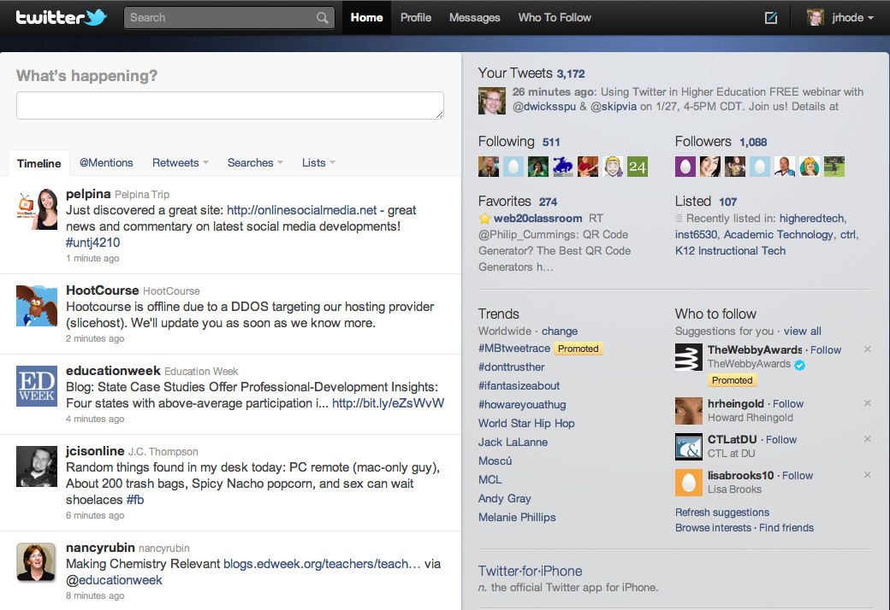
The Web: Twitter.com

Slide 25
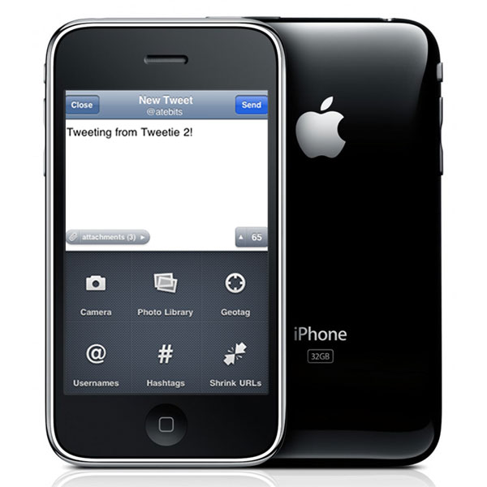
Twitter App: Smart Phone

Slide 26
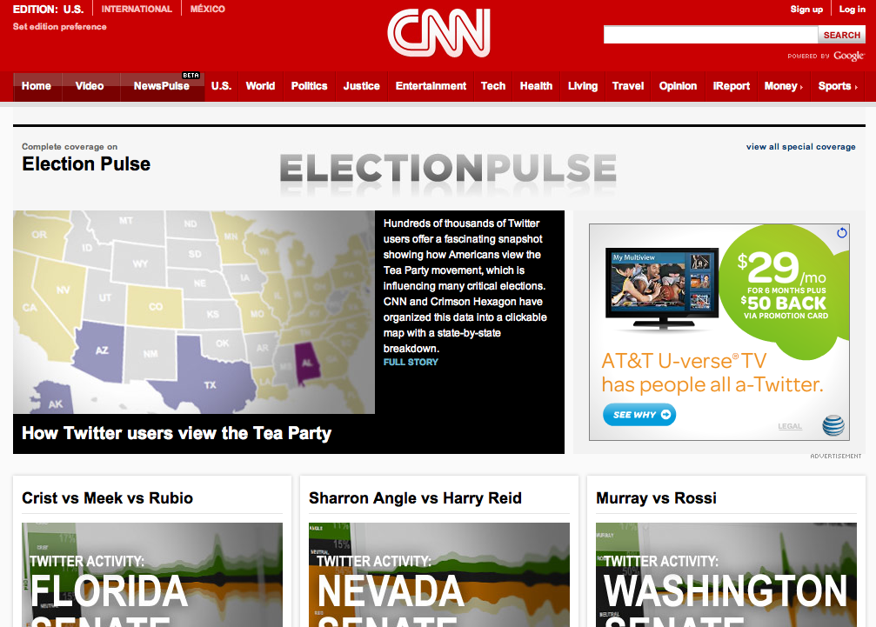
Election Coverage on Twitter
http://www.cnn.com/SPECIALS/2010/election.pulse

Slide 27
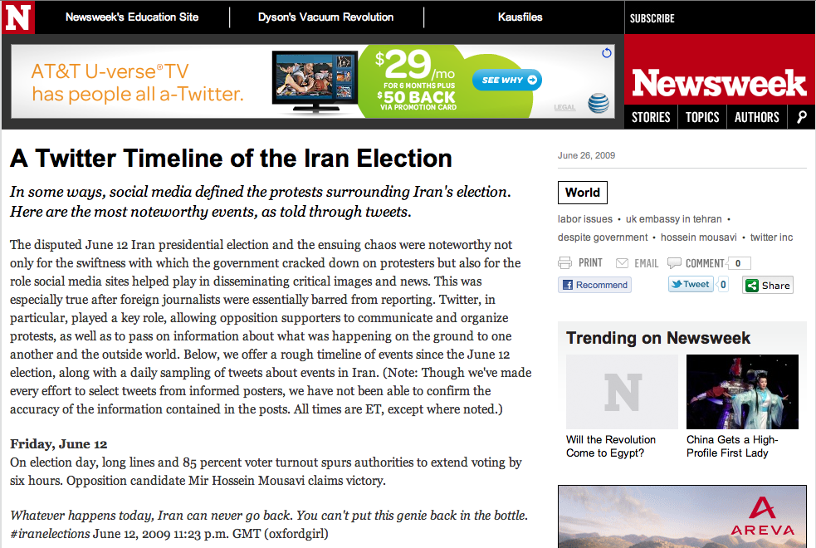
http://www.newsweek.com/2009/06/25/a-twitter-timeline-of-the-iran-election.html

Slide 28
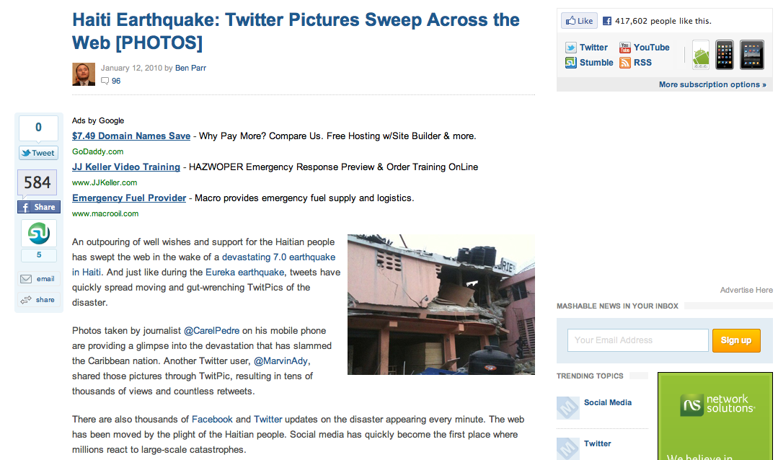
Haiti Earthquake
http://mashable.com/2010/01/12/haiti-earthquake-pictures

Slide 29
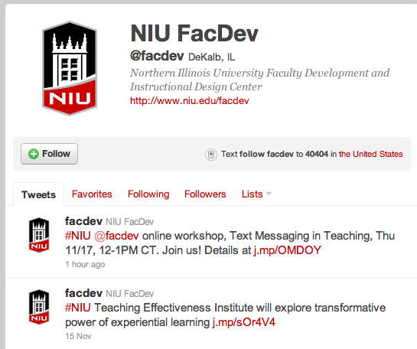
Following Others
Following someone on Twitter means:
a) you are subscribing to their Tweets as a Follower
b) their updates will appear in your timeline
c) that person has permission to send you private Tweets, called direct messages

Slide 30
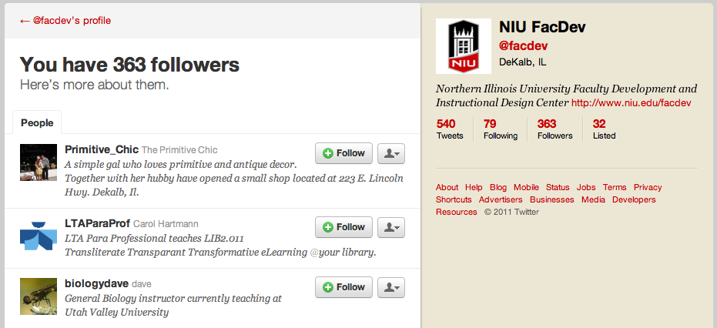
Followers
People who receive your tweets

Slide 31
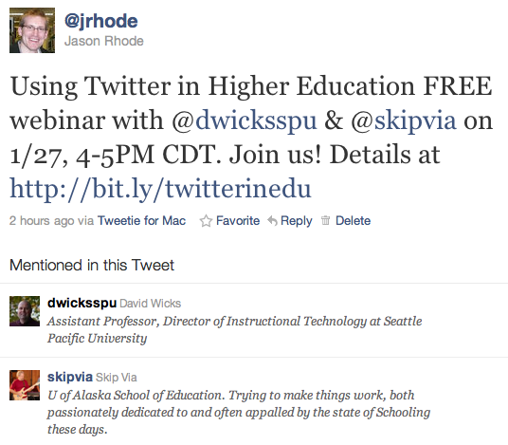
Anatomy of a Tweet

Slide 32
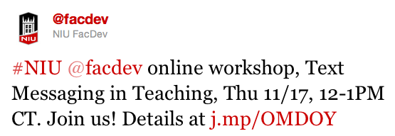
Hashtag (#)
The # symbol, called a hashtag, is used to mark keywords or topics in a Tweet. It was created organically by Twitter users as a way to categorize messages.

Slide 33
@Mention
Any Twitter update that contains @username anywhere in the body of the Tweet. (Yes, this means that replies are also considered mentions).

Slide 34
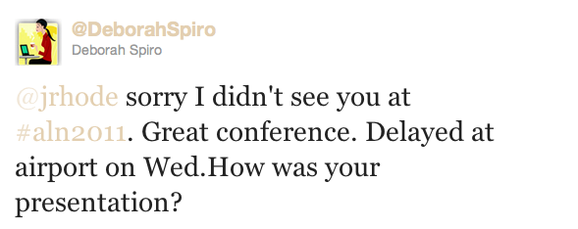
@Reply
Public reply to another Twitter user, always beginning with @username

Slide 35
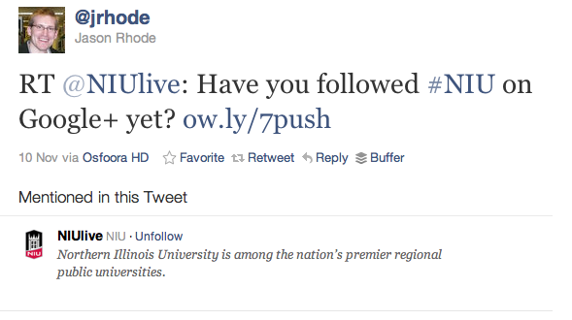
Retweet (RT)
Tweet that is reposted to your followers, either by clicking the “Retweet” link on the Twitter website or by beginning a tweet with RT @username

Slide 36
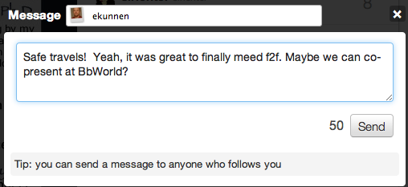
Direct Message (D)
Private message sent via Twitter to one of your followers

Slide 37
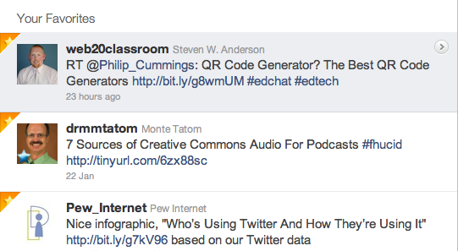
Favorites
Favorites, represented by a small star icon next to a Tweet, are most commonly used when users like a Tweet and wish to save it for later.

Slide 38
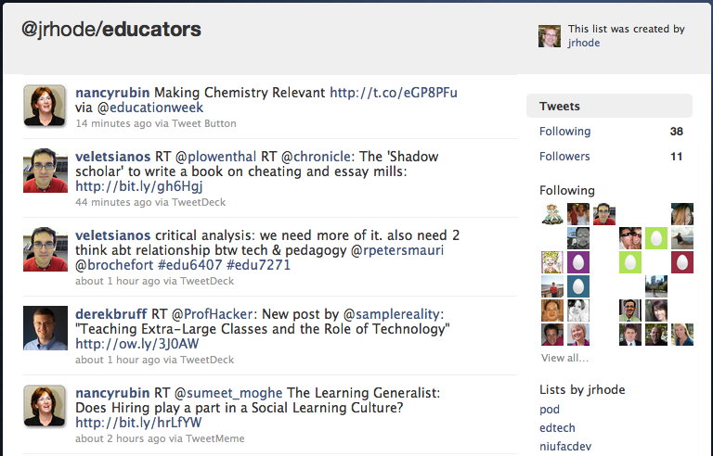
Lists
Collections of other users

Slide 39
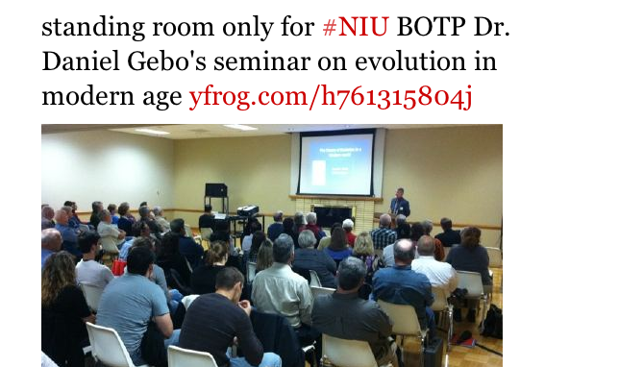
Tweet Photo

Slide 40
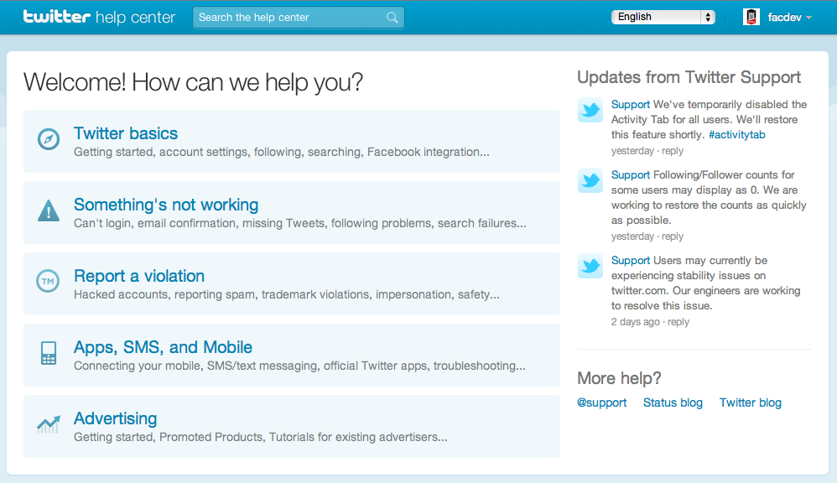
Twitter Help Center
support.twitter.com

Slide 41
Social Media: Differentiating Your Unique Brand
If you are in a mid-size or larger company, your company probably has an integrated marketing social media business plan, but YOU are also your own brand
How can you most effectively utilize social media in your life?

Slide 42
Enhance Social Media with Cross Links
Helps contacts, customers and potential clients find you and keep you as a source for information
Tells search engines (like Google or Bing) that your social profiles are all related –\
pre-emptively occupies Google Page 1, making it more difficult for negative press to float to top
Syndicates content—
Reduces the need to create new content for every site daily

Slide 43
Tips to Enhance Social Media Platforms
If utilizing Facebook for professional reasons, best to create two accounts –one linked with professional, and one personal and private
Can cross link: eg social media icons on website, blogs that link to LI, Facebook, Twitter, LinkedIn can integrate Twitter feed
Participate in conversations about your industry, can set up reminders via free tools to flag keywords (industry, competitor names) –Hootsuite, GoogleAlerts, TweetDeck, Socialmention.com

Slide 44
Integrating Social Media
Choose the platforms that will enhance your business initiative
you don’t need to join every site, and it’s useless to join if you aren’t interacting.
Understand the site’s culture and/or rules
sometimes unspoken
Stay relevant and top of mind
Follow through on commitments
Thank others for helping you
Do what you say you will, and thank others for helping you

Slide 45
Types of social networkers
• Alpha Socialisers – (a minority) people who used sites in intense short bursts to flirt,meet new people, and be entertained.
• Attention Seekers – (some) people who craved attention and comments from others,often by posting photos and customising their profiles.
• Followers – (many) people who joined sites to keep up with what their peers were doing.

Slide 46
Types of social networkers(conti.)
Faithfuls – (many) people who typically used social networking sites to rekindle old friendships, often from school or university.
• Functionals – (a minority) people who tended to be single-minded in using sites for a particular purpose.
Source: Ofcom Social Networking Sites research, September-October 2007

Slide 47
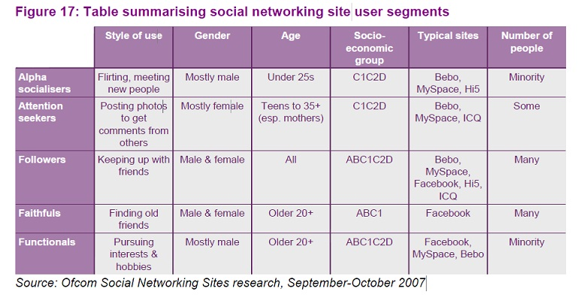

Slide 48
Privacy concerns
Social networking sites provide privacy options but users are generally unaware or tend to ignore such concerns
Stalkers, terrorists, ill-doers, con-artists could benefit from such issues
Recent scandals-England :MI-6’s director’s wife puts up photos of family on facebook.
Facebook’s controversial decision to make visible relationship actions to entire social group

Slide 49
Security issues
Recent malware exploiting social networks
Malicious Banner ads
Adware
Phishing attacks
Customizable scripts

Slide 50
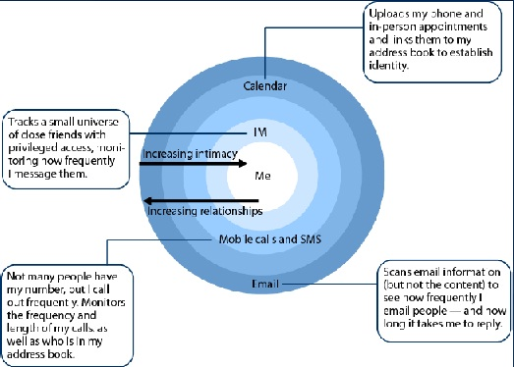
Social and Psychological issues
Increasing relationships but decreasing intimacy

